Slide 1
Data Analysis Report
Project 3
Danlei Qian
May 6，2019

Slide 2

Date Sources
SEX OF WORKERS BY MEANS OF TRANSPORTATION TO WORK
https://www.census.gov/newsroom/stories/2019/bike-month.html

Slide 3
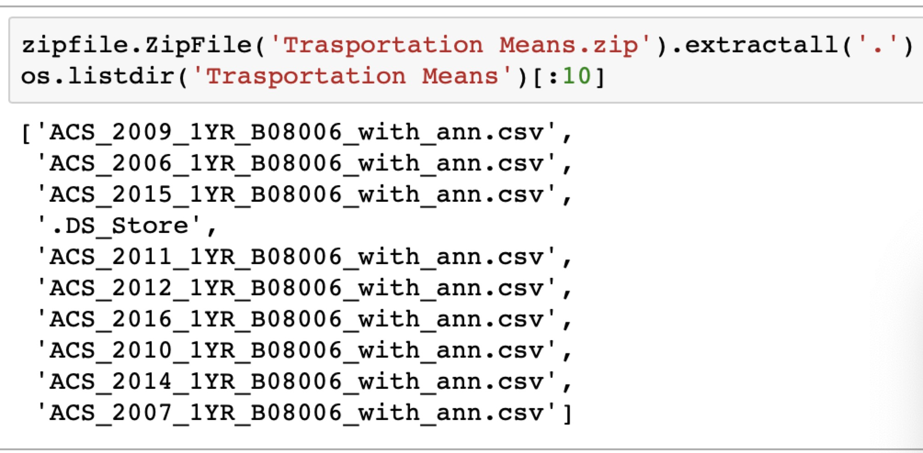
Data Cleaning and Preprocessing
STEP 2
zipfile.ZipFile()

Slide 4
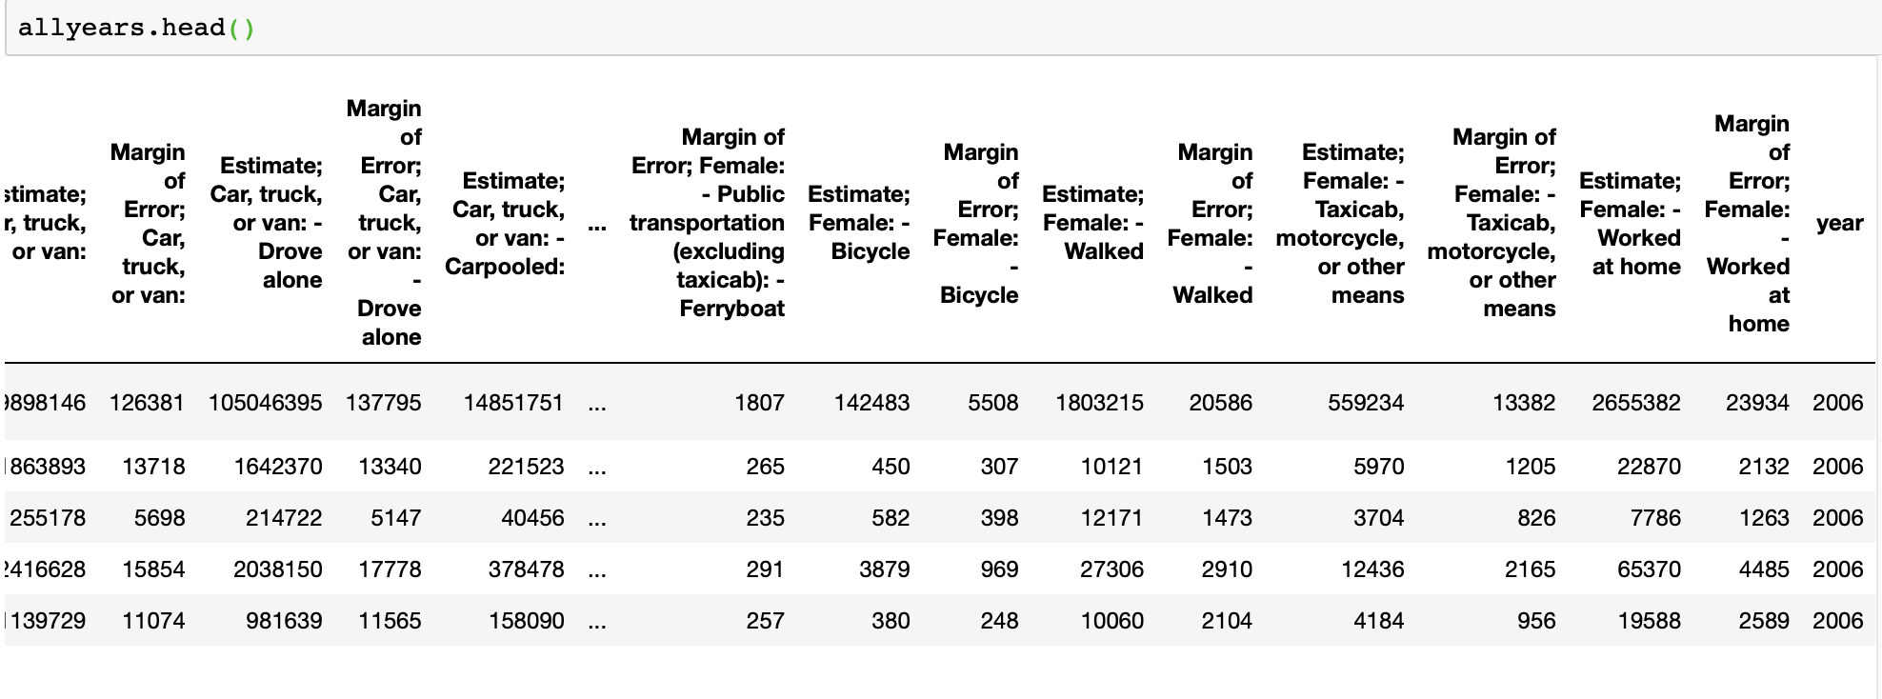
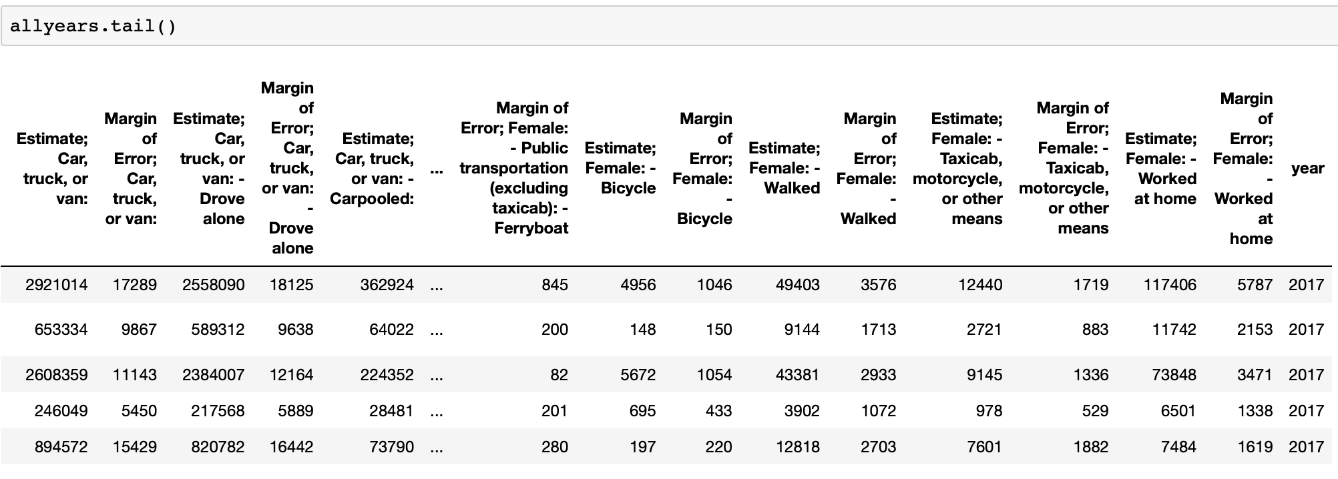
Data Cleaning and Preprocessing
STEP 3
For loop & .append() & .concat()

Slide 5
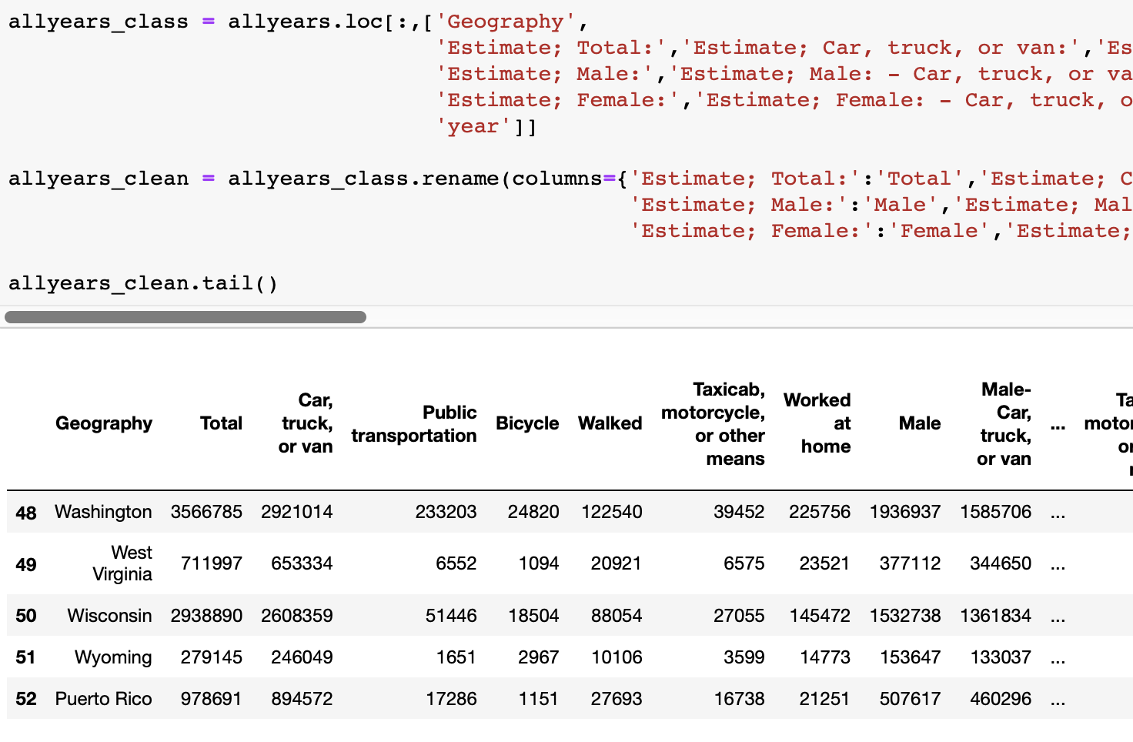
Data Cleaning and Preprocessing
STEP 4
.loc() & .ix()

Slide 6
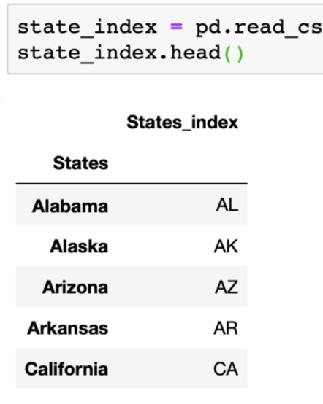

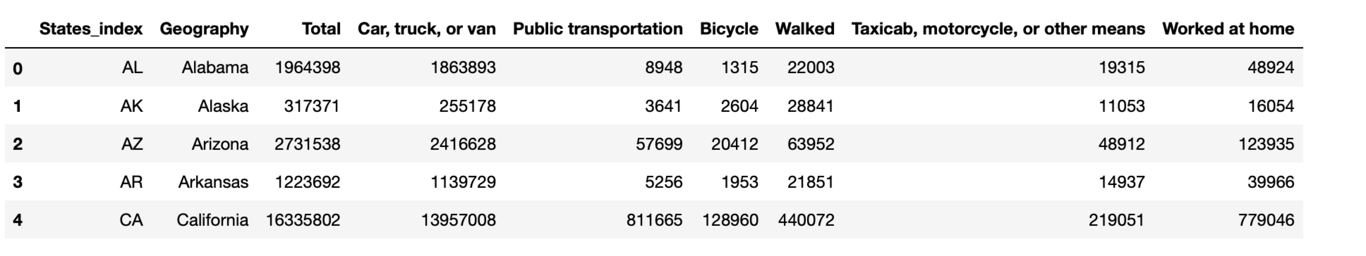
Data Cleaning and Preprocessing
STEP 5
.merge()

Slide 7

Data Analysis
1.0 Bases on years

Slide 8
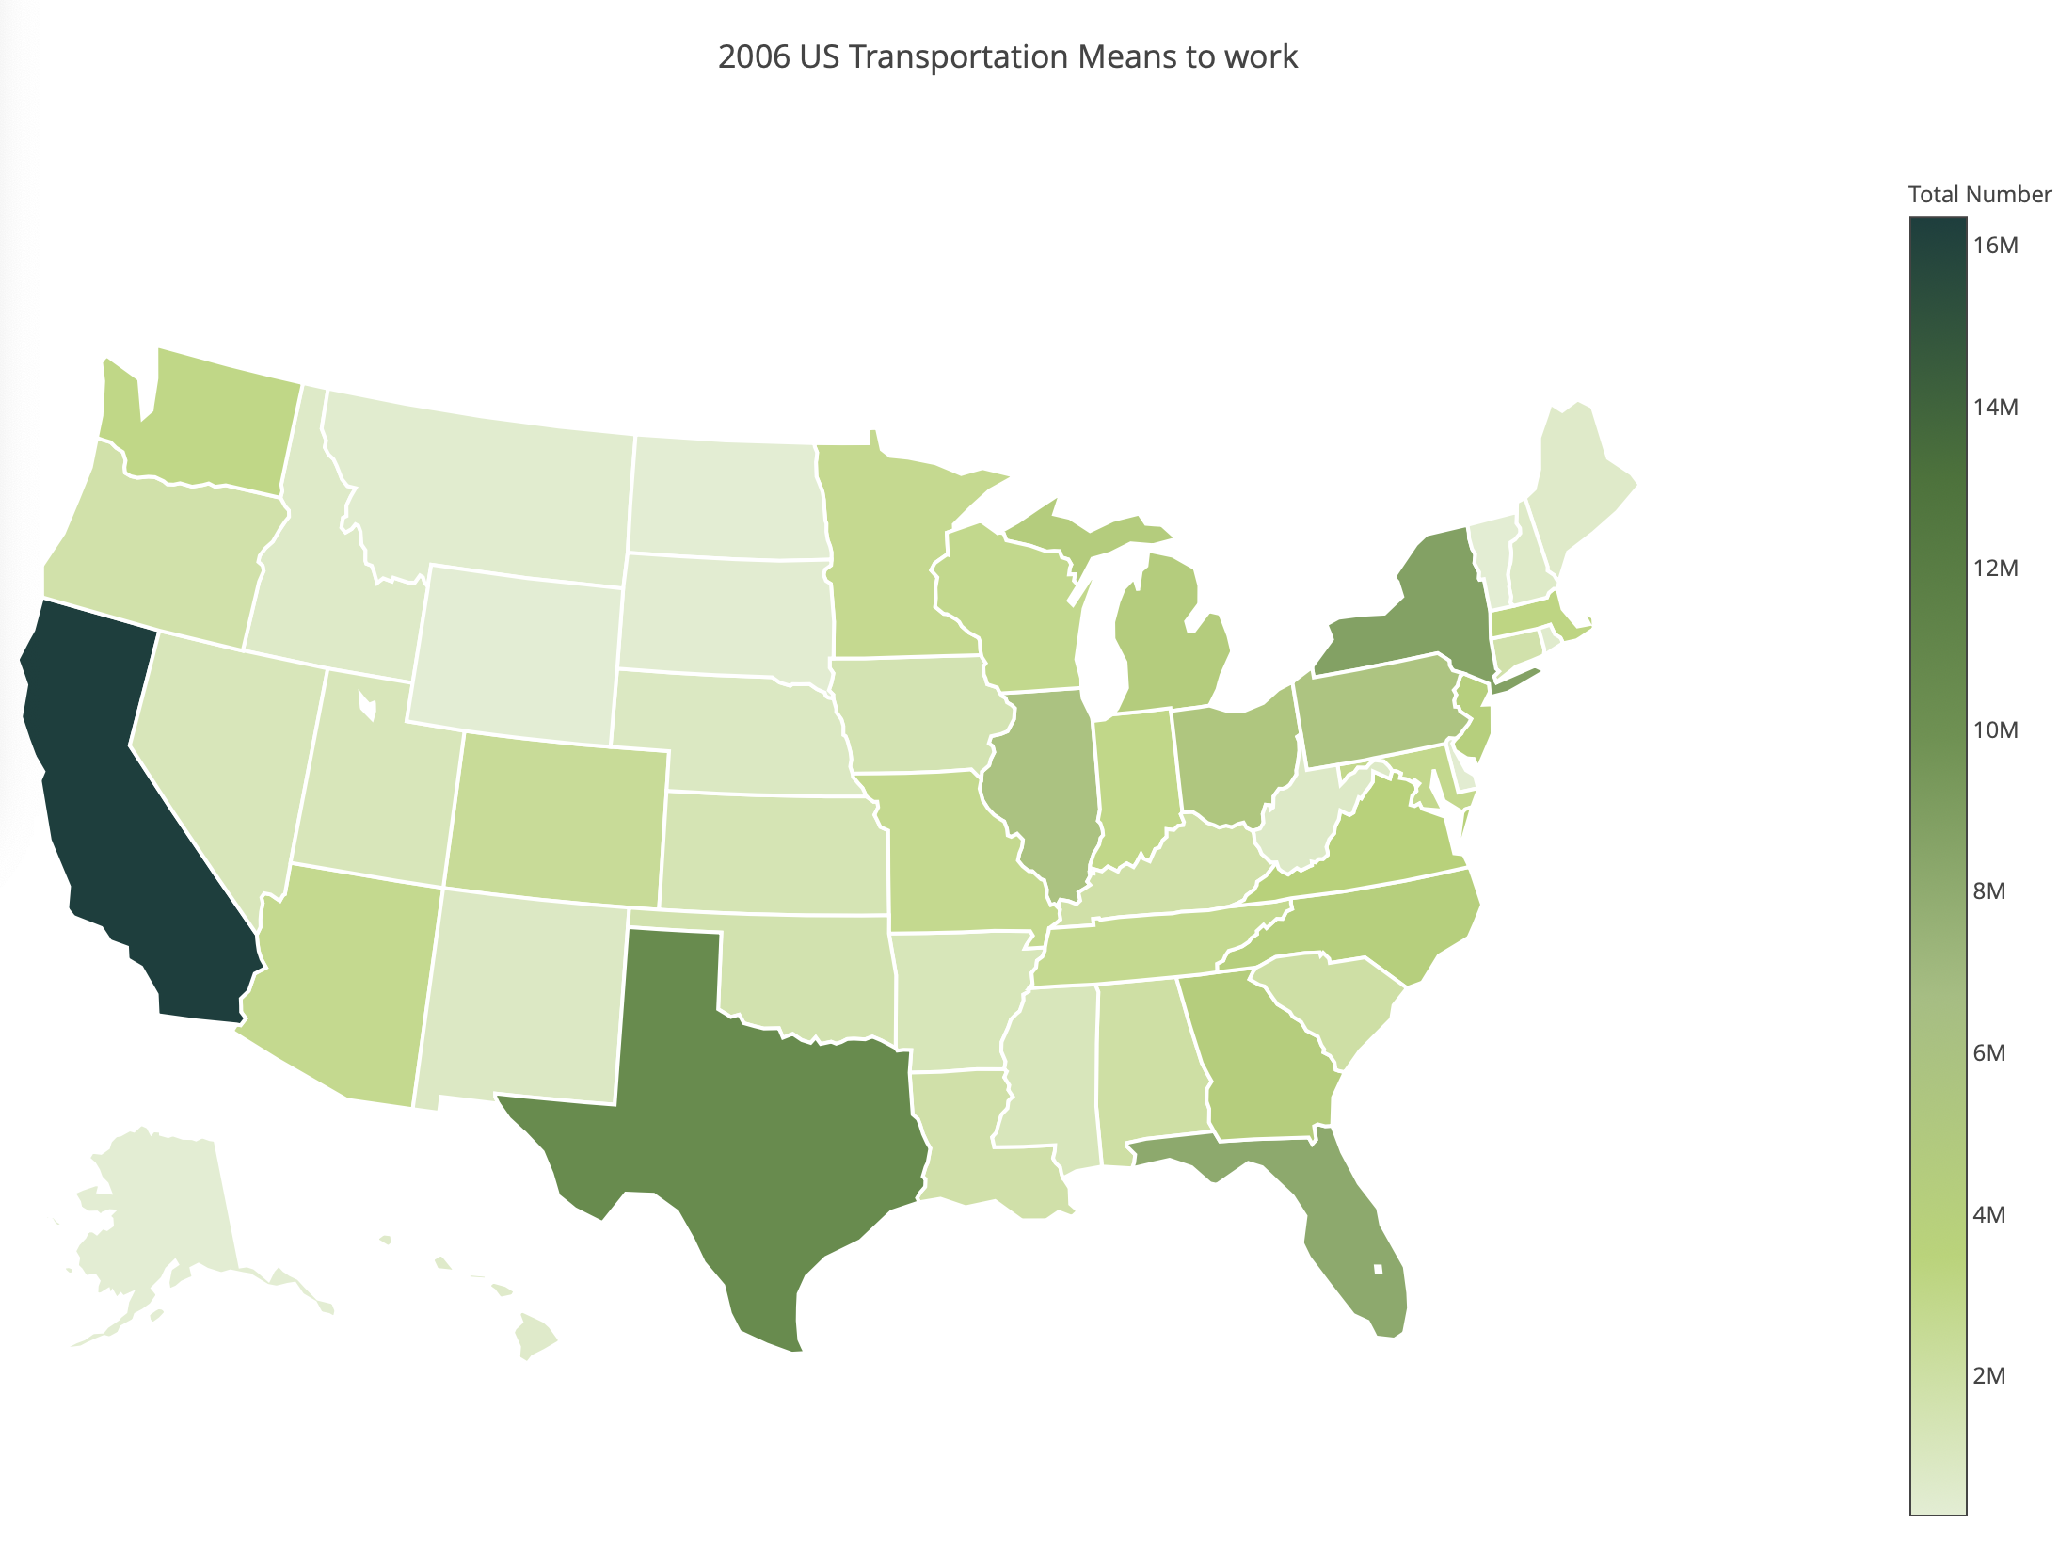
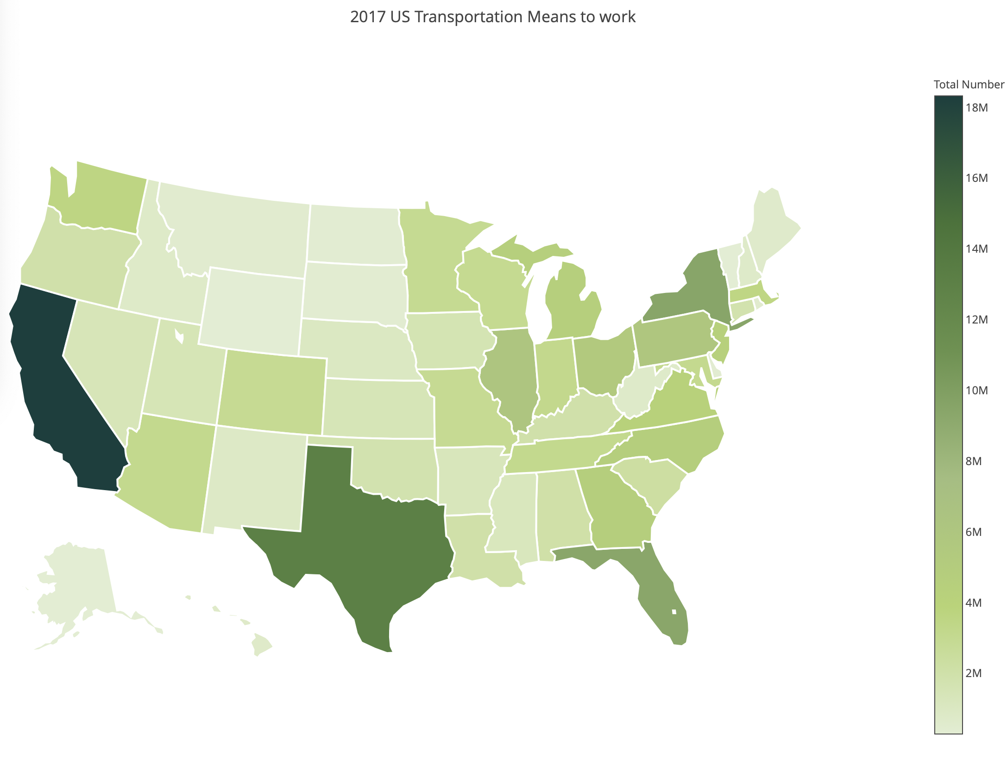
Data Analysis
2.0 Based on States

Slide 9
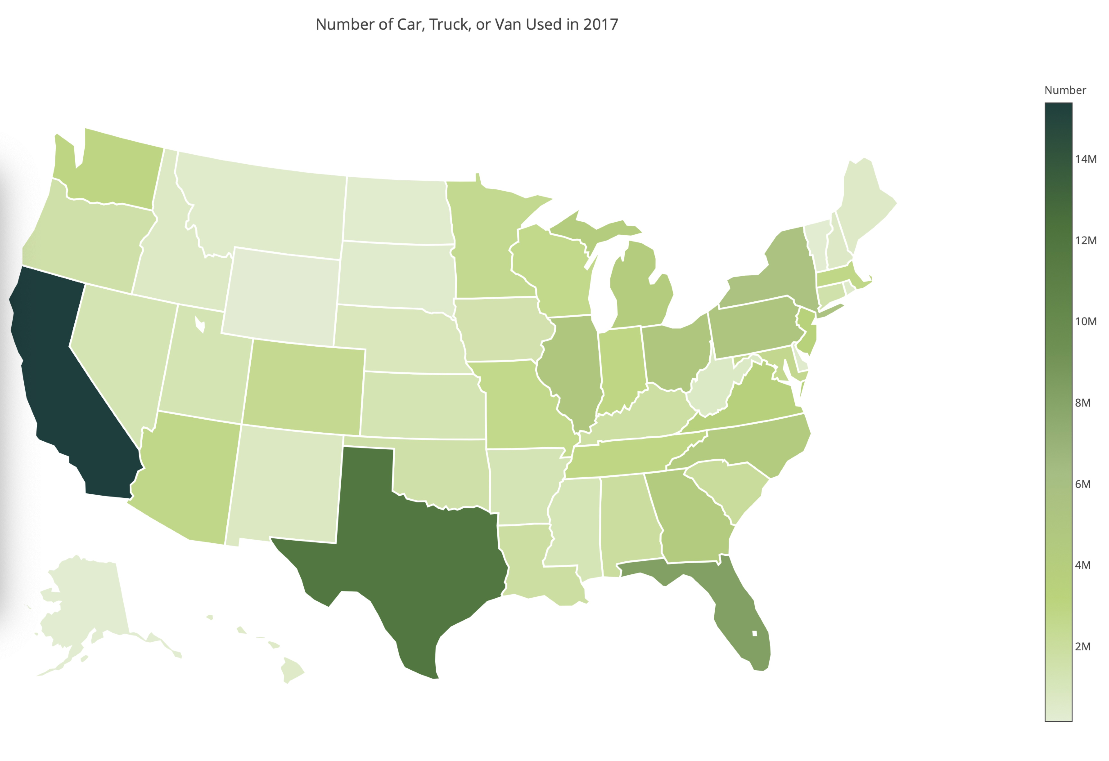
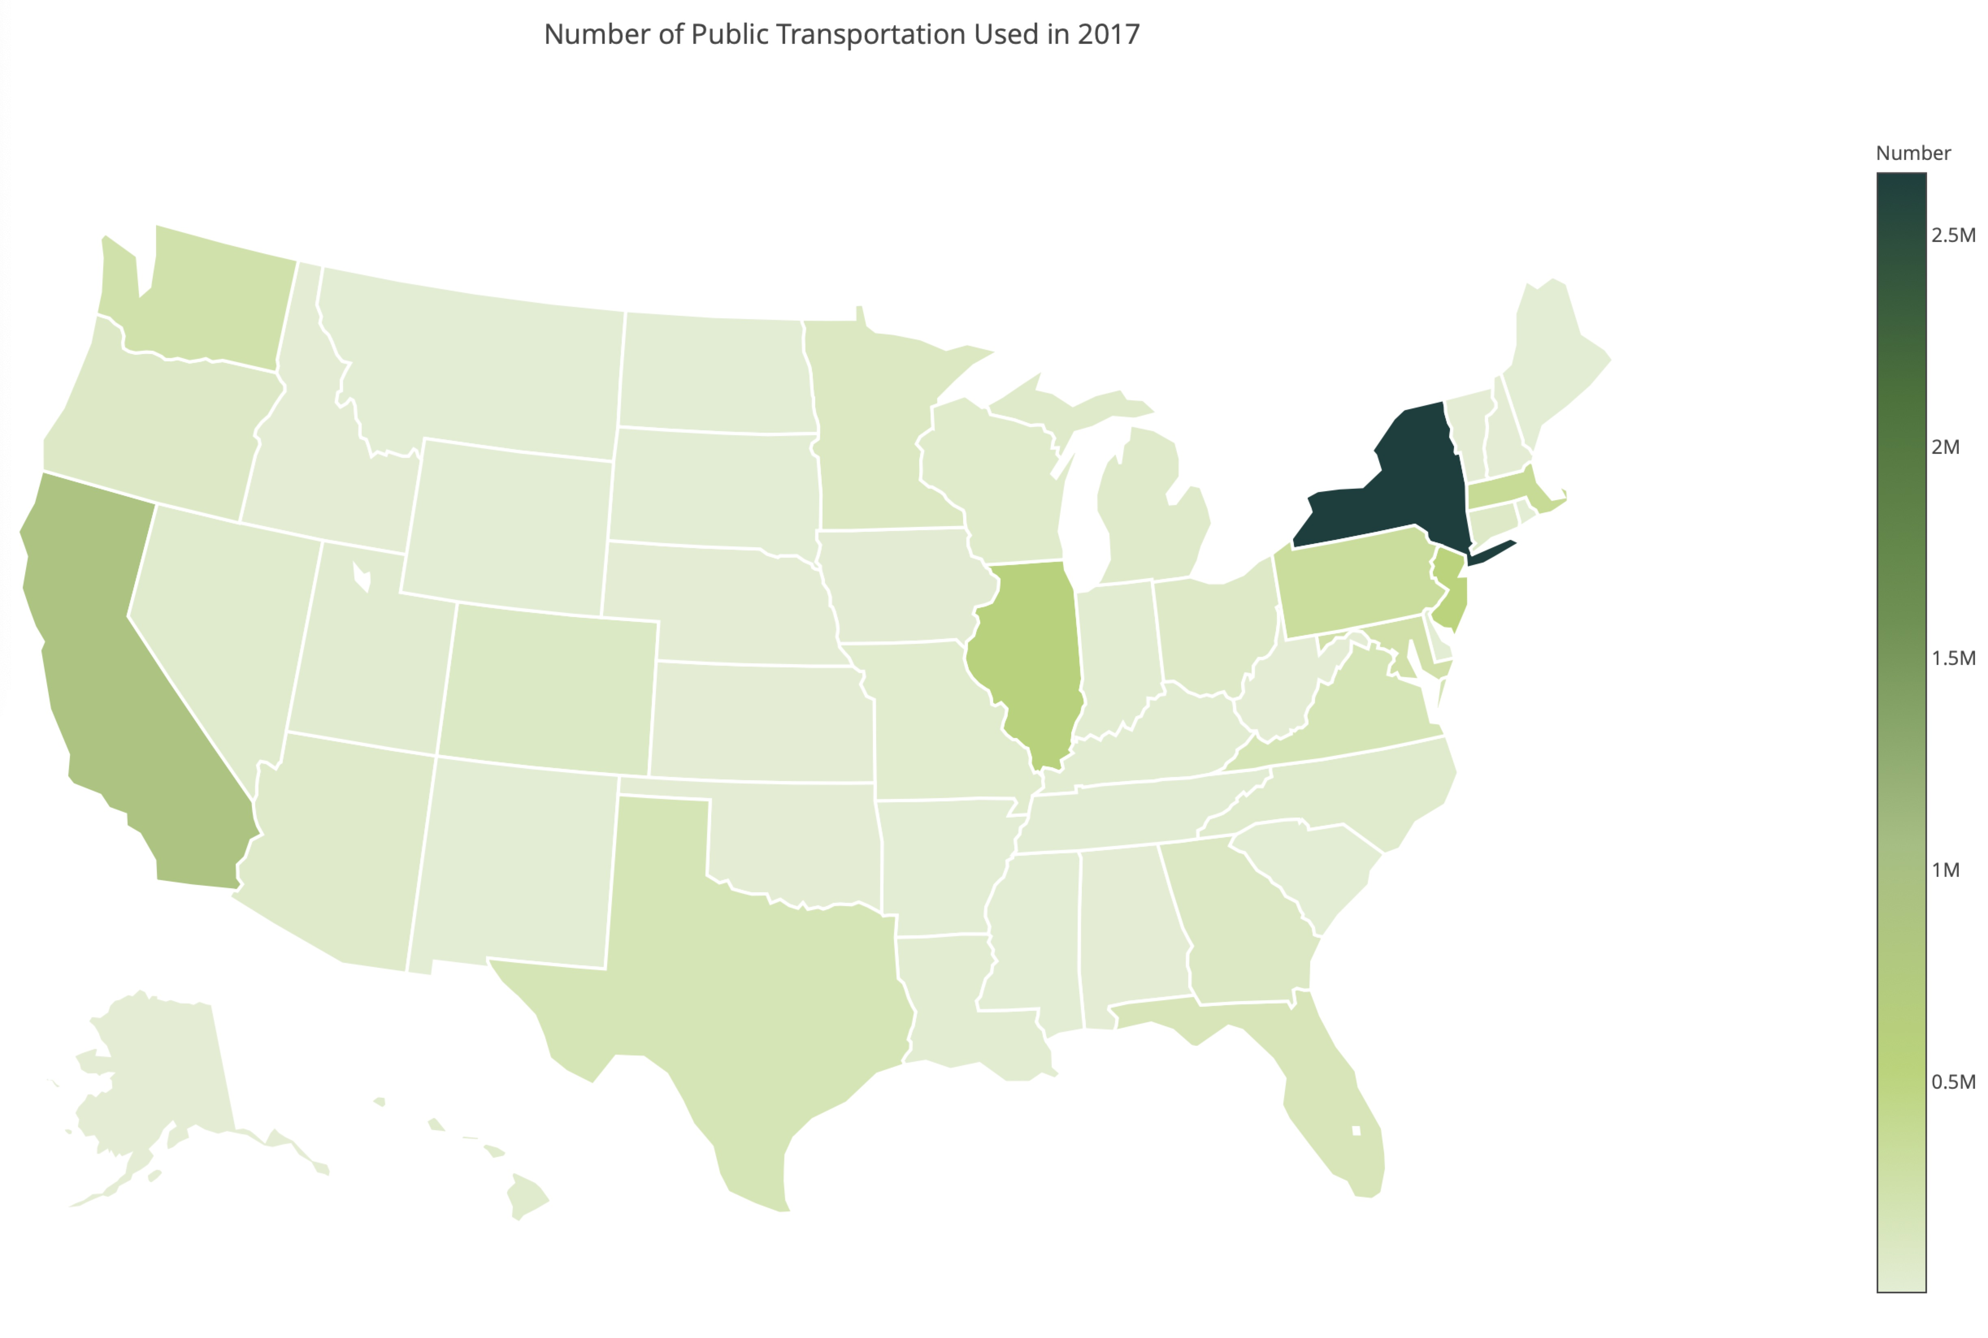
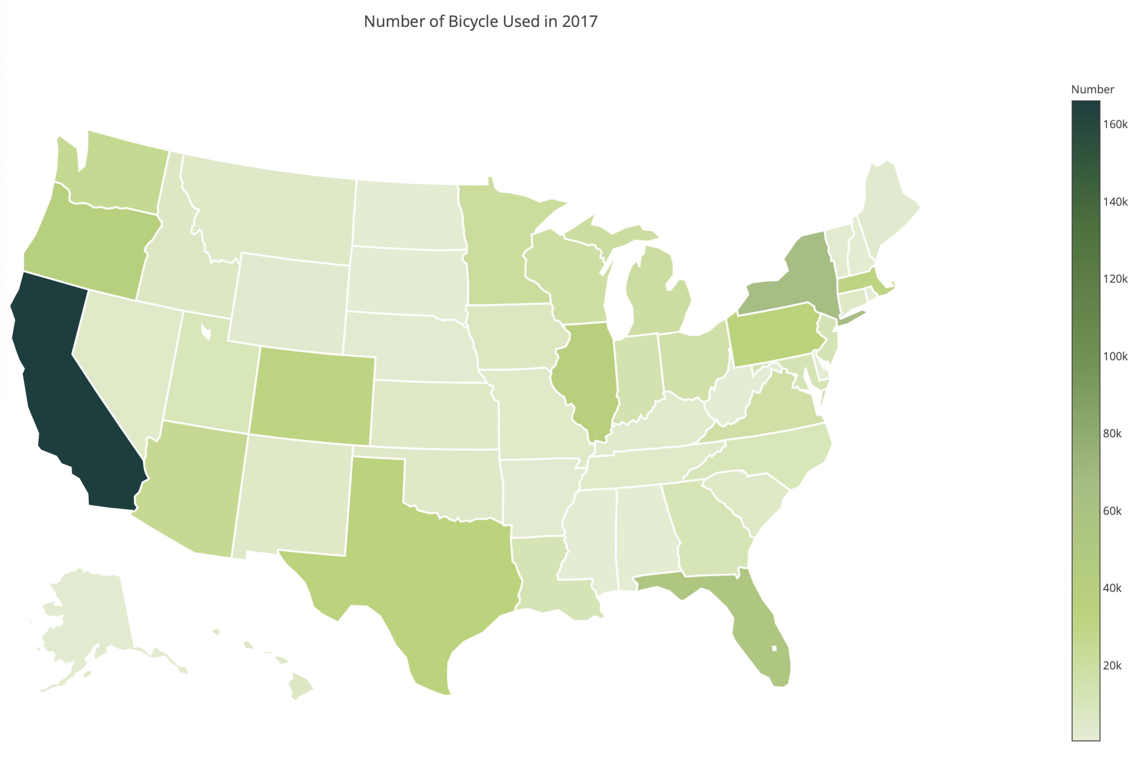
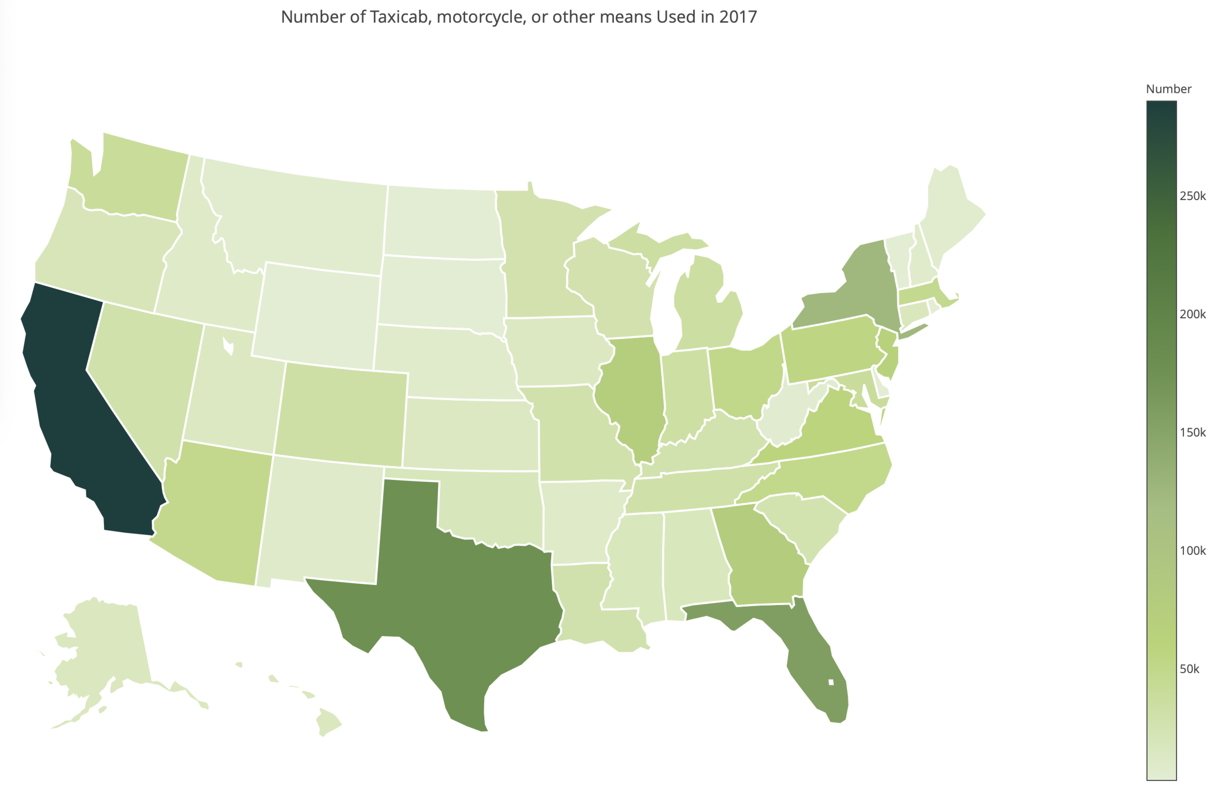
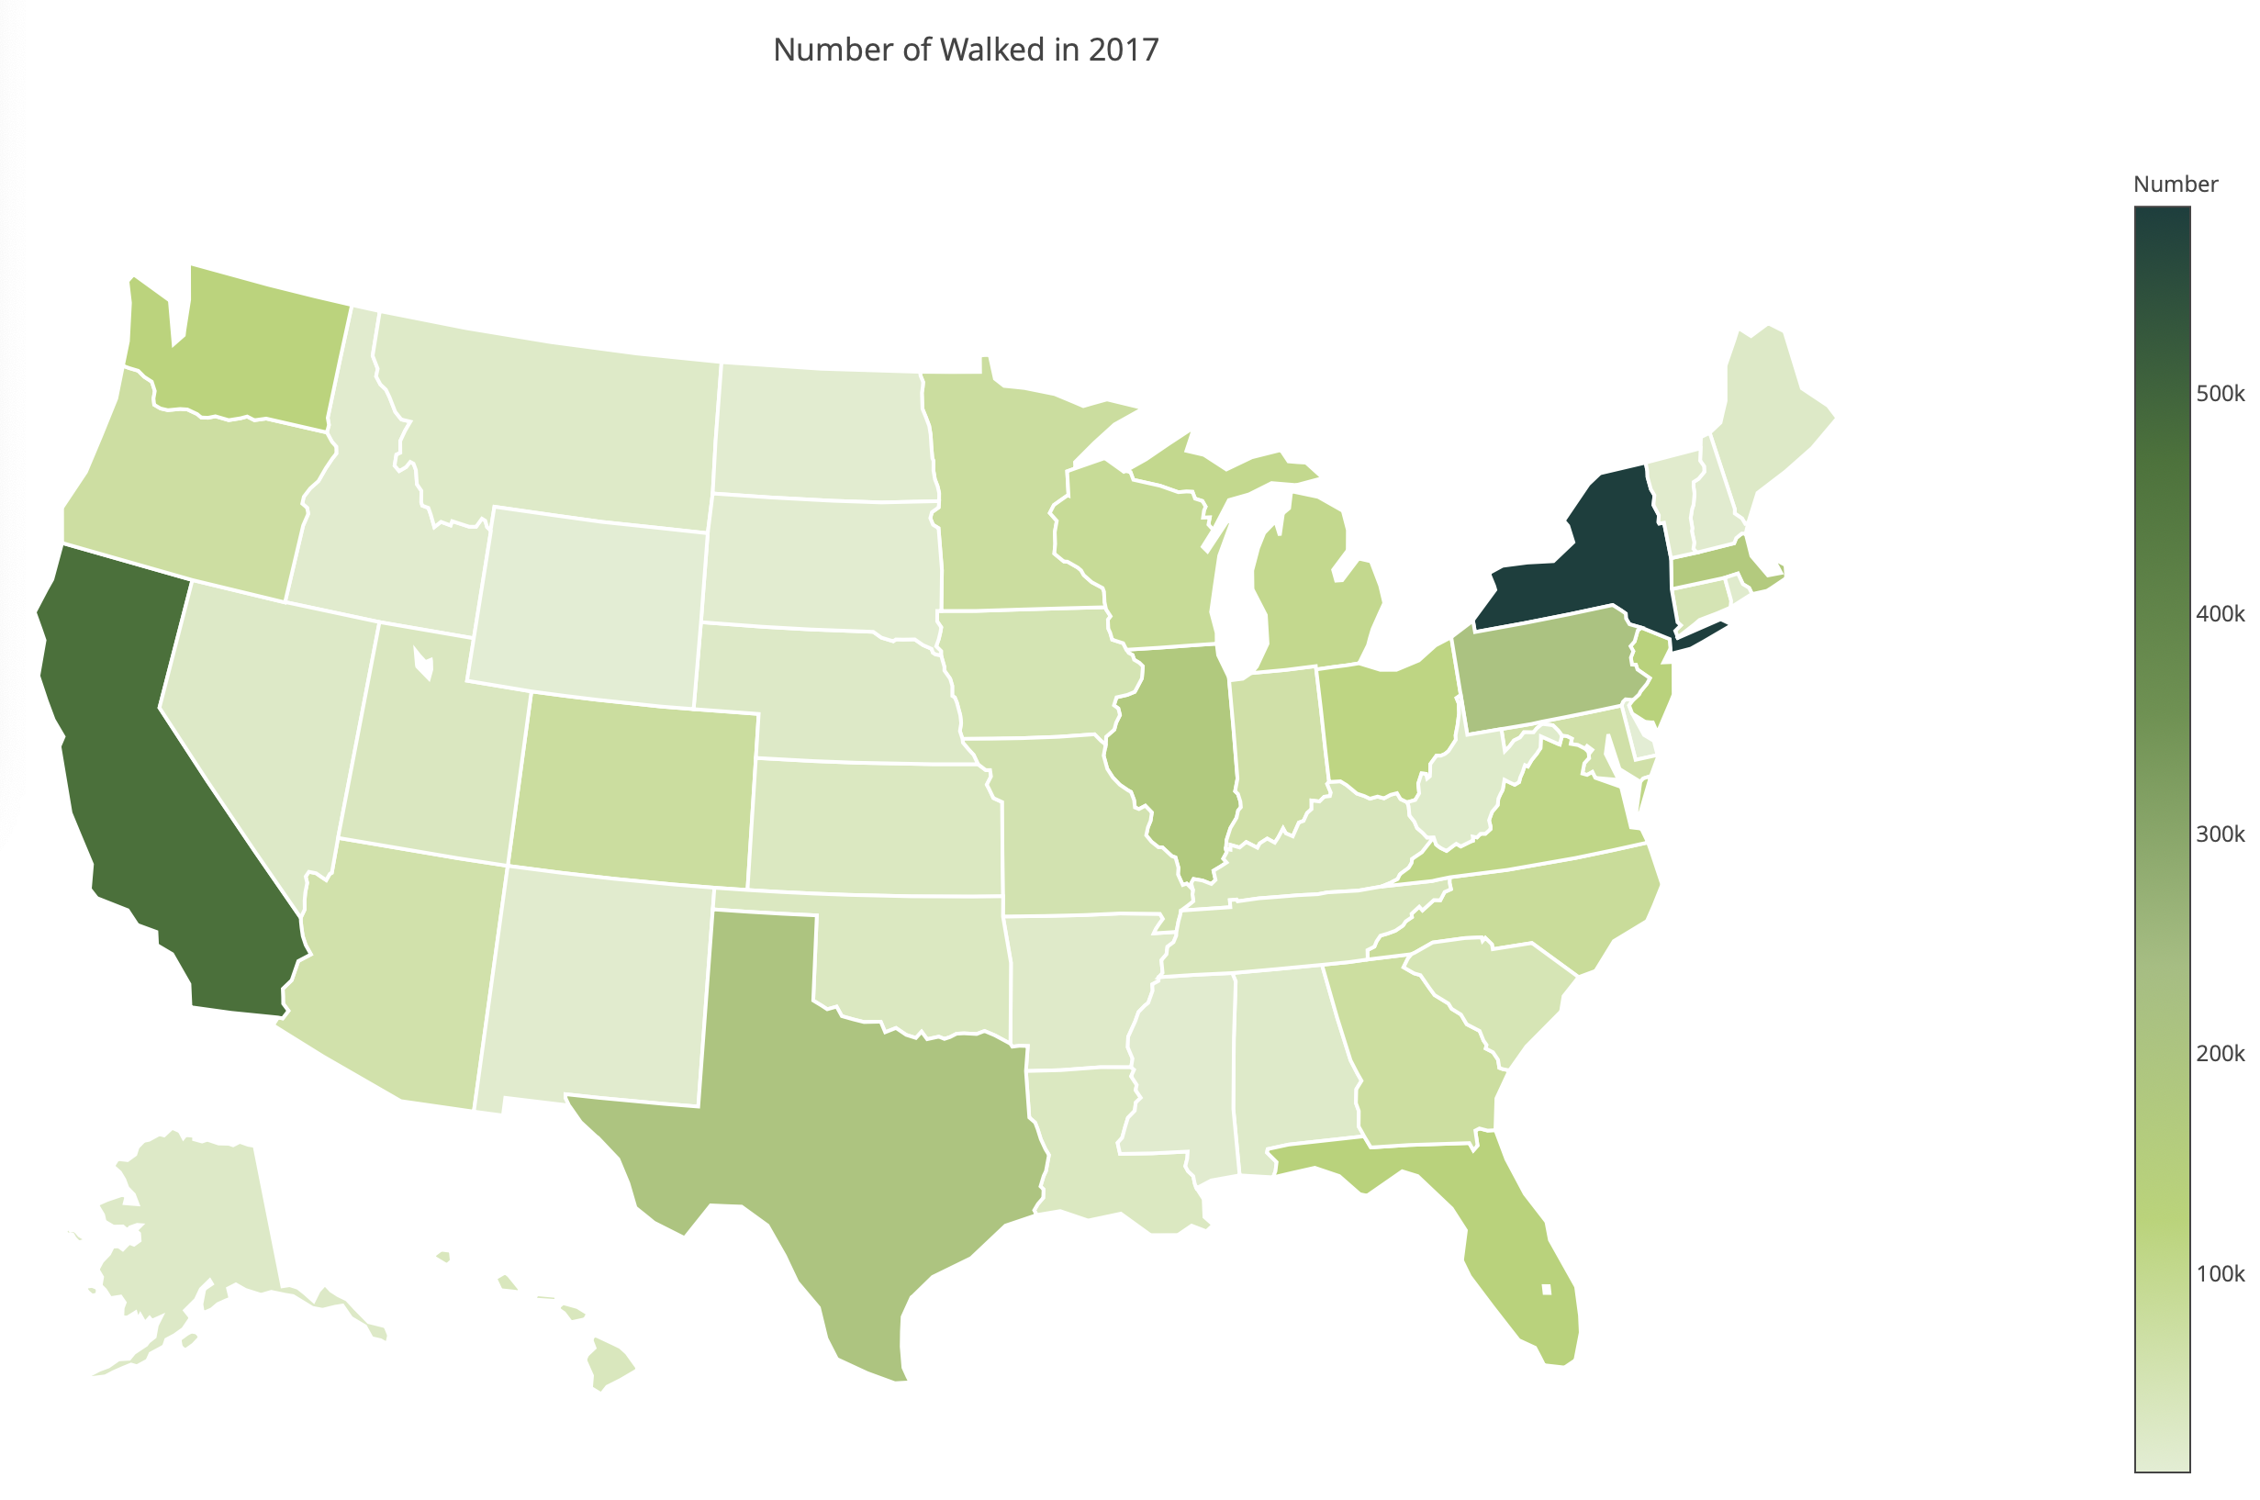
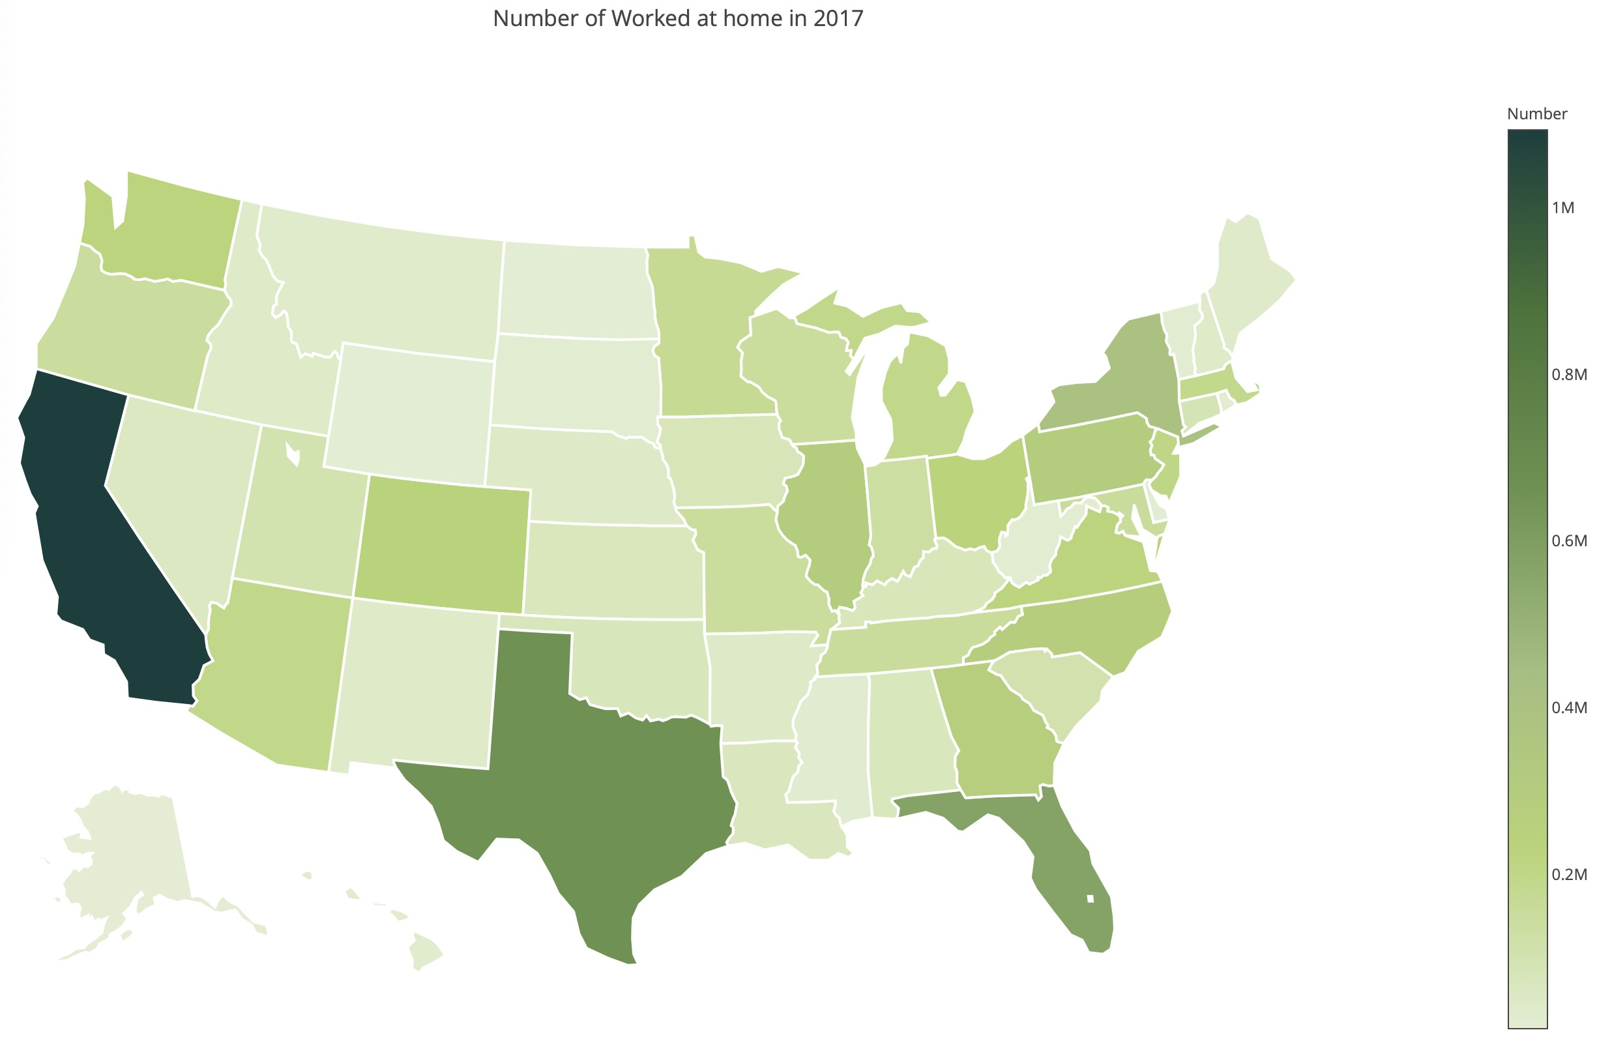

Data Analysis
2.0 Bases on States

Slide 10
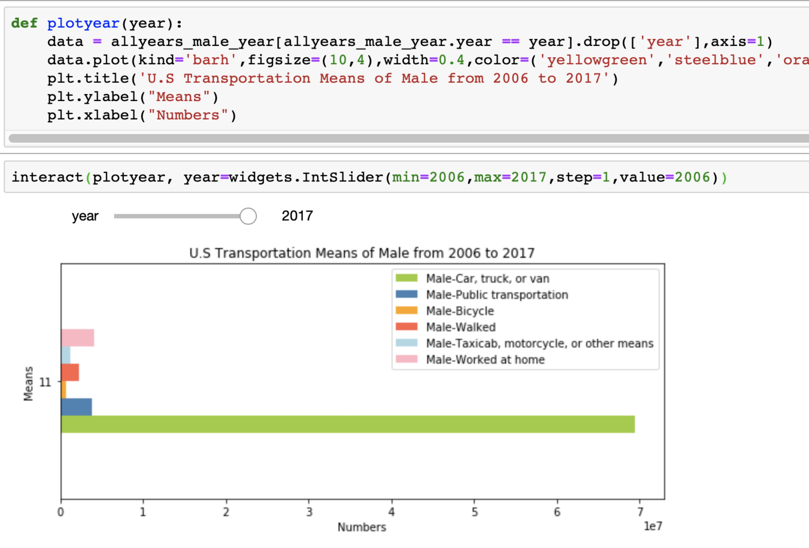
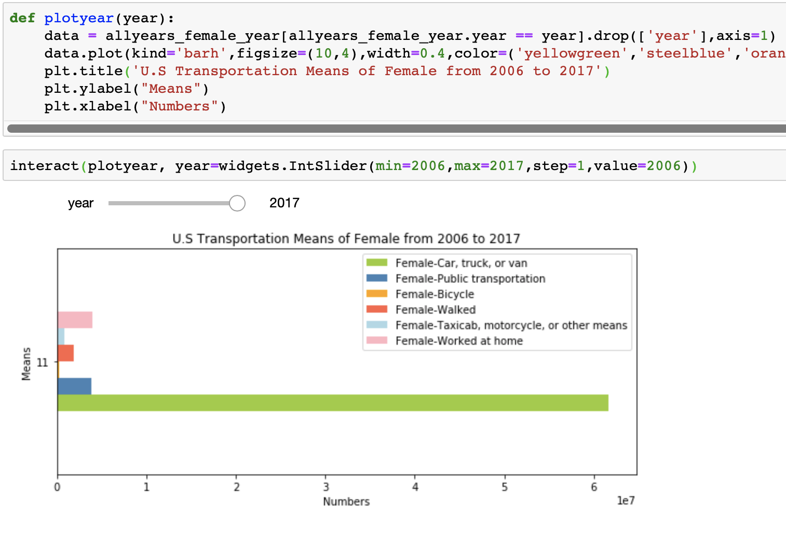
Data Analysis
3.0 Bases on gender

Slide 11
Conclusion
The use of cars, truck and van always keep a high level and a steady speed growth.
Other transportation do not have obvious trends.
Over the time period(2006-2017), the overall distribution of transportation means is constant, but it is worth to notice that Texas seems to have a deeper color, which may reflecting the development and the increase of population.
The number of females who ride bicycle is quite small and who use taxicabs and motorcycles is less than males.
More People choose work from home now compared to the 10 years ago.

